Slide 1
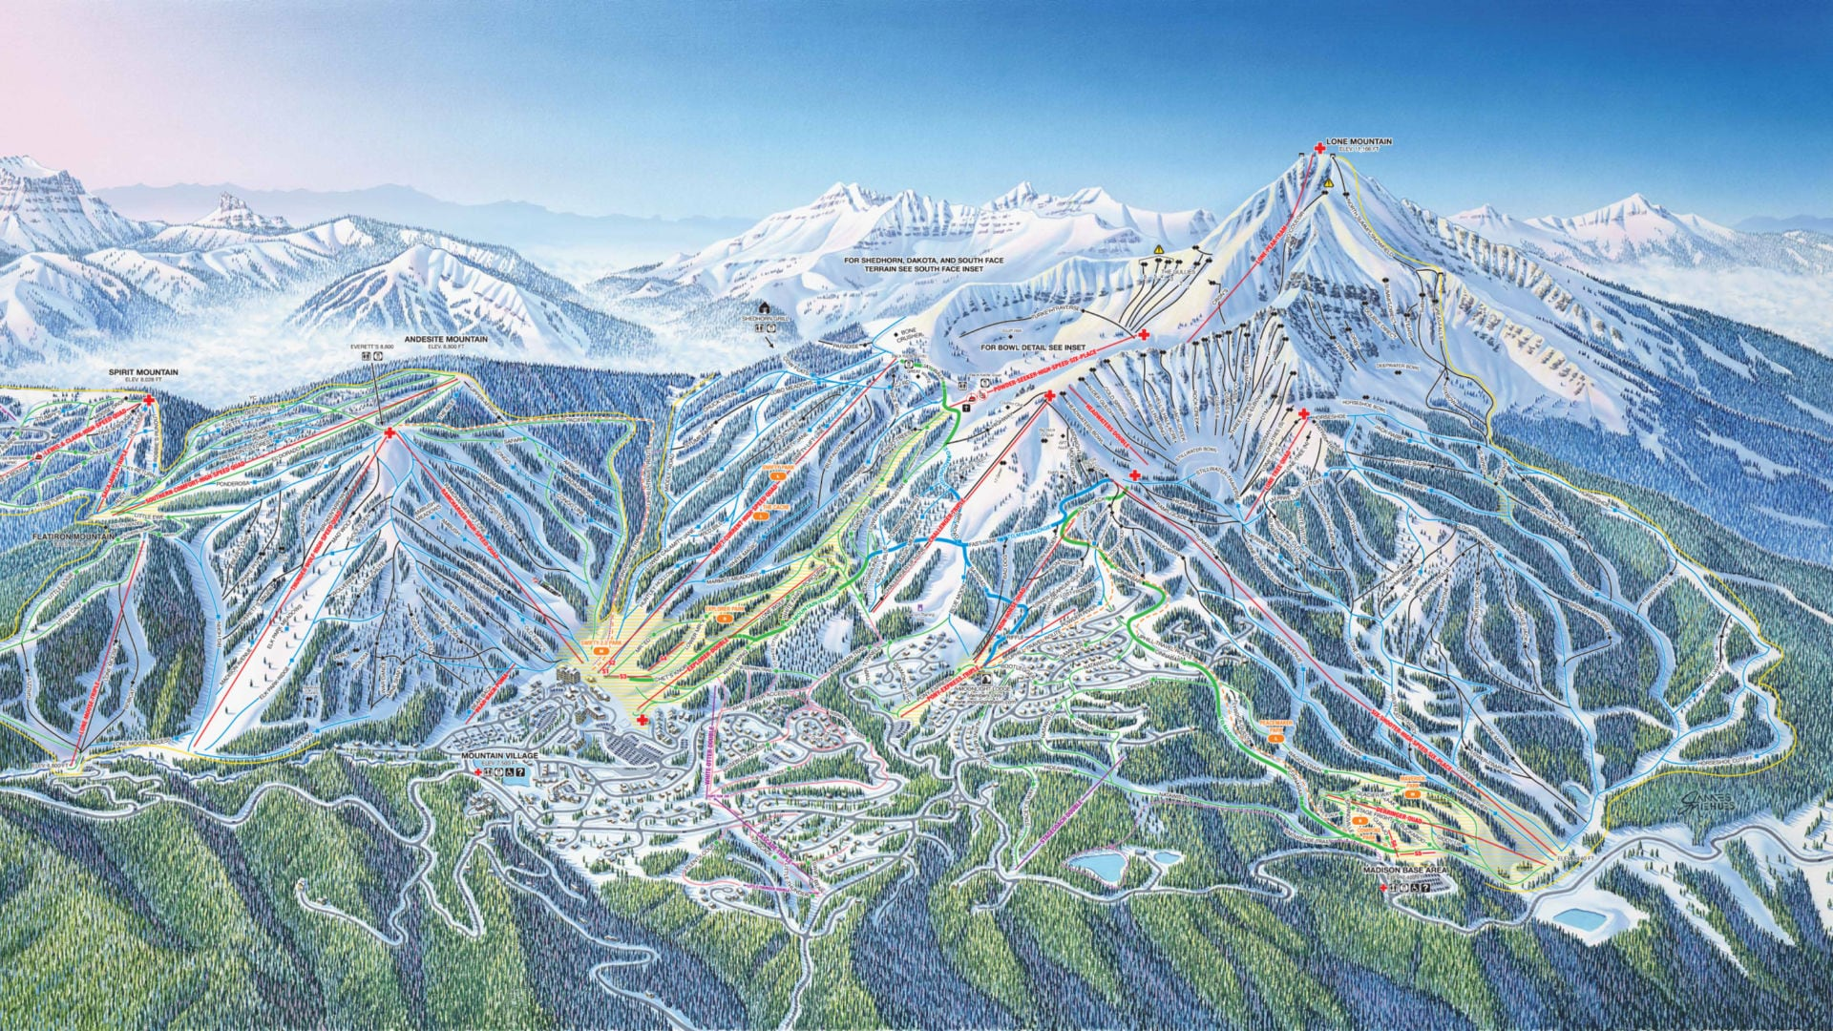
Big Mountain resort ticket price recommendations
Shen Dong, Data Scientist
Blabla Consulting Inc.

Slide 2
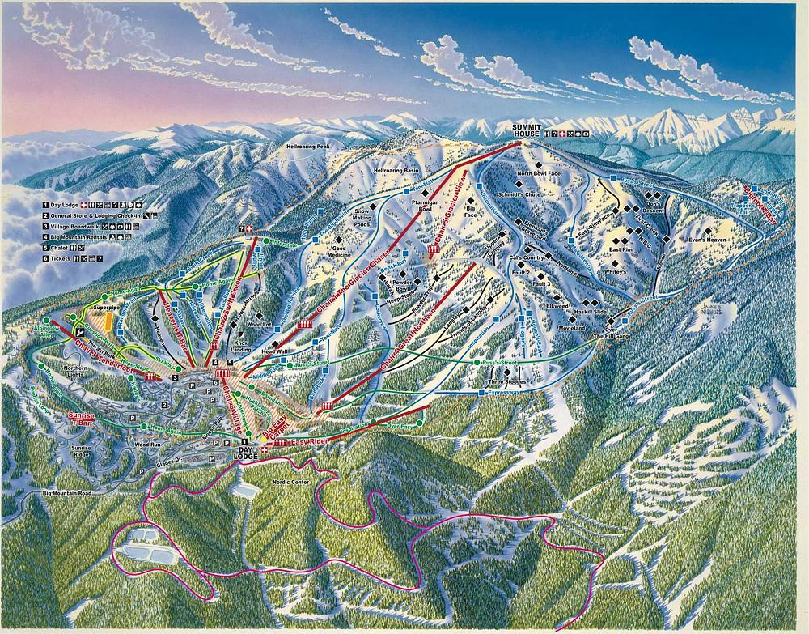
Problematic
Big Mountain Resort:
premier ski destination
vistas of Glacier National Park and Flathead National Forest
105 trails
350,000 enthusiasts eager to carve through its slopes.
Recently, the resort made a significant investment in a new chair lift, elevating its operational costs for the upcoming ski season of an extra $1.5 million.
How can BMR implement a new pricing strategy that will allow to cover for the cost of its last ski lift but still staying competitive enough within its market share?

Slide 3
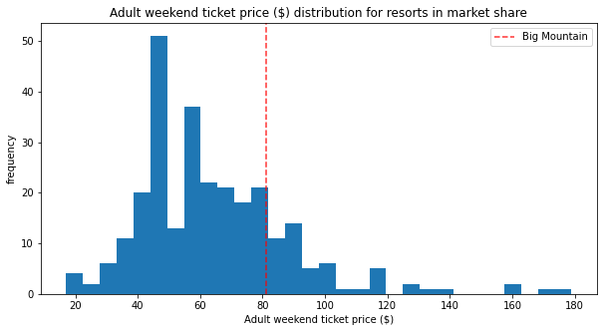
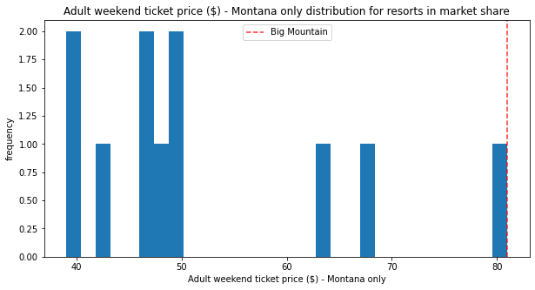
Big Mountain Resort actual price
The ticket price for BMR is $81, which is approximately $20 higher than the average ticket price of all resorts within its market share. Among all the resorts in Montana, BMR has the highest ticket price.

Slide 4
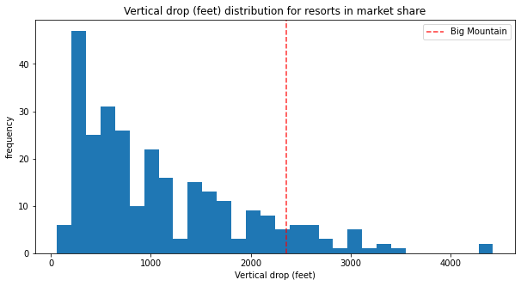
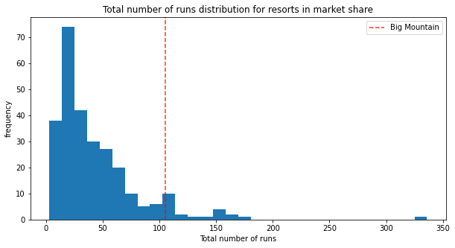
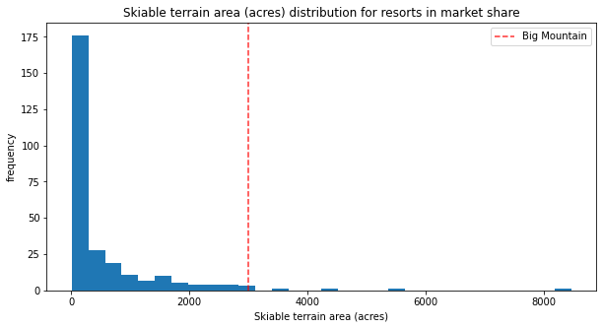
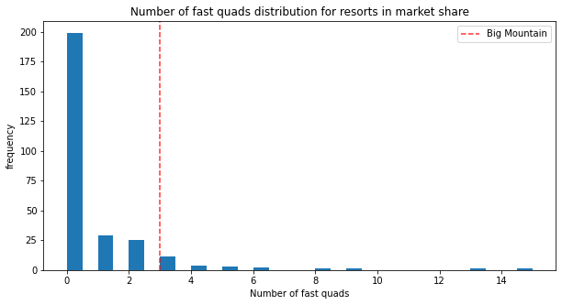
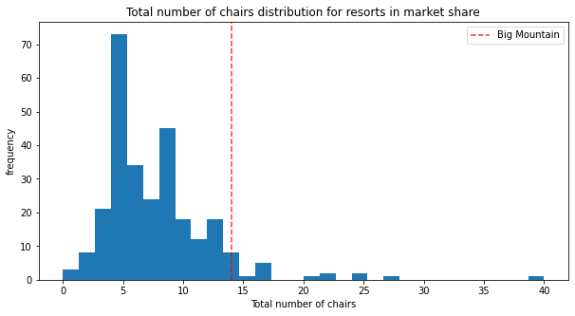
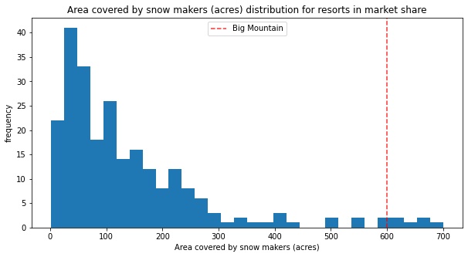
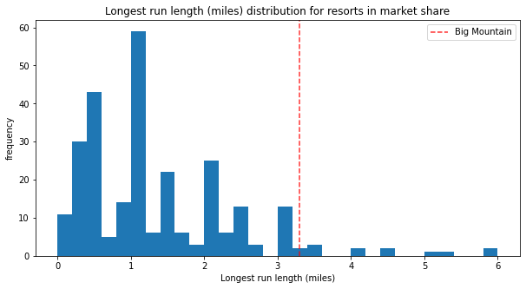
Big Mountain Resort actual price
Considering the high-value features that BMR presents, we recommend an increase in the ticket price, despite it being the highest among Montana resorts.

Slide 5
Modeling
Leveraging a dataset of 276 resorts that are part of the same market share than BMR and we applied our predictive model over 36 resort features in order to identify the most important ones and predict the adequate price for the BMR.
2 regression models were used:
Linear regression
Random forest regression
Modeling scenarios: Estimation of the ticket price and revenue if:
BMR were to close 1 to 10 runs
BMR would add a run, increasing the vertical drop by 150 feet, and installing an additional chair lift.
BMR would add 2 acres of snow making.
BMR would increase the longest run by 0.2 miles and guarantee its snow coverage by adding 4 acres of snow making capability.

Slide 6
Modeling results - Impact of numbers of closed runs on price and revenues
Our ticket price and revenue changes projections indicate that closing one run will not impact either costs or revenue.
However, closing between one and five runs will result in a cost loss of approximately one million dollars. If six to ten runs are closed, the lost revenue will increase significantly, ranging from two to three million dollars

Slide 7
Modeling results – Impact of enhancement of resort features
Feature Enhancement | Ticket price Increase | Extra revenue | Final ticket price | Total revenue from tickets
No enhancement | $13.22 | $23,135,000 | $94.22 | $164,885,000
Add: 1 run 150 ft vertical drop 1 chair lift | $15.21 | $26,617,500 | $96.22 | $168,367,500
Add: 2 acres covered by snow making machines | $15.21 | $26,617,500 | $96.22 | $168,367,500
Add: 0.2 miles to the longest run 4 acres covered by snow making machines | $15.21 | $26,617,500 | $96.22 | $168,367,500

Slide 8
Recommendations
Our model indicates that BMR's current ticket price is underpriced compared to other resorts in the same market share. We recommend increasing the price to $94.22 per ticket.
Adding acres covered by snow machines or extending the longest run has no significant impact on the ticket price.
Additionally, an extra increase of $1.99 (generating an additional $3.48 million in revenue) could be considered if BMR adds another run with a lift chair, increasing the vertical drop by 150 feet.

Slide 9
Summary and conclusion
Big Mountain Resort’s actual ticket price is underpriced compared to other resort within the same market share.
Given the current amenities and to better align with market trends of comparable resorts, we recommend a price increase of $13.22, raising the final price to $94.22 per tickets. This adjustment would result in a total gain of $23 million for the season.
Additionally, an extra increase of $1.99 (generating an additional $3.48 million in revenue) could be considered if BMR adds another run with a lift chair, increasing the vertical drop by 150 feet.
To determine if the revenue generated from the new price will cover the $1.5 million cost of the new chair lift, we need to know the total operational cost of the BMR resort.
To implement cost-cutting strategies by closing runs, we need the operational cost of each run and must model different scenarios to make accurate predictions

